Slide 1
Ring, Ring… Whose there? The Law!?!?
Wes Bearden, CEO Bearden Investigative Agency, Inc.
Attorney & Investigator
Dallas, Houston & New Orleans

Slide 2
SPEAKER
Wes Bearden , CEO & Chairman Attorney & Investigator

Slide 3
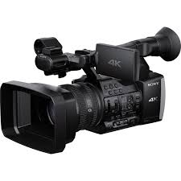
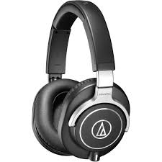
Base Rules
Audio v. Video
Audio has primarily been governed by statutes, namely the wiretap act.
Video is applicable to statutes but, primarily analyzed by common law / right to privacy analysis.
“Reasonable Expectation of Privacy”

Slide 4
Wiretap Acts Texas v. Federal
Electronic Communications Privacy Act of 1986 (“ECPA”)
Tex. Penal Code Ann § 16.02
One-Party Consent Rule

Slide 5
What is the One-Party Rule?
Both Federal and State statutes, including Texas prohibit interception of a voice communication unless at least one party to the communication knows of and consents to the interception at the time of interception. 18 USCA 2510 et seq.; Tex. Penal Code Ann § 16.02.
CAN YOU RECORD ME RIGHT NOW????

Slide 6
BUT, I OWN THEM…

Slide 7
BUT, Beware of these Two-Party States
(1) California.
(2) Connecticut.
(3) Florida.
(4) Illinois.
(5) Maryland.
(6) Massachusetts.
(7) Montana.
(8) New Hampshire.
(9) Pennsylvania.
(10) Washington.

Slide 8
Two- Party
Tango
Issues

Slide 9
CONSENT
Can be implicit. But, these are narrow. Such as:
Vicarious Consent (For the best interests of you child).
It is in the ordinary course of business (911 operator or security operator NOT real estate).
Jail house conversations.

Slide 10
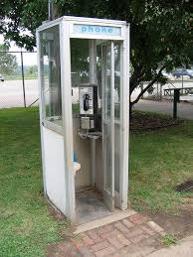
And sometimes you don’t need consent?
Reasonable Expectation of Privacy, Katz Test. Mid 1960s.
"first that a person have exhibited an actual (subjective) expectation of privacy and, second, that the expectation be one that society is prepared to recognize as 'reasonable.’”
Basically, it depends on the facts. But think it through…
Loud Talking on the front lawn?
Conversation in a vacant home.

Slide 11
What about in Public?
Courts primarily look to considerations such as: (1) the volume of the communication or conversation; (2) the proximity or potential of other individuals to overhear the conversation; (3) the potential for communications to be reported; (4) the affirmative actions taken by the speakers to shield their privacy; (5) the need for technological enhancements to hear the communications; and (6) the place or location of the oral communications as it relates to the subjective expectations of the individuals who are communicating.

Slide 12
Examples
1) Grandmother and father of murdered children who brought suit under 18 USCS § 2511 because their private prayers and conversations were recorded at outdoor grave site memorial service by electronic surveillance microphone placed in funeral urn did not demonstrate that genuine issue of material fact existed as to their reasonable expectation of privacy in their oral communications, and thus court did not err in awarding summary judgment in favor of city, police officers and assistant district attorney; grandmother and father adduced no evidence regarding context of communications that they sought to characterize as private. Kee v. City of Rowlett, 247 F3d 206 (5th Cir. 2001).
2) Reporter records political meeting in hotel courtyard and records some voices with a hidden unenhanced audio hearing. Allows evidence to be heard that recording a private conversation in public could be an intrusion. Stephens v. Dolcefino, 126 S.W.3d 120 (Tex. App.—Houston [1st Dist.] 2003).

Slide 13
Ok, the showing?
Can you record the audio of the showing?
NO, unless you are part of the conversation. Which the Seller is almost never there.

Slide 14
What about Cameras? Wiretap Act doesn’t apply to non-audio video.

Slide 15
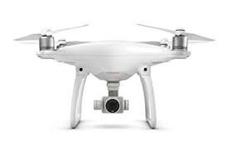
Criminal Video
Improper Photography or Visual Recording; Texas Penal Code § 21.15
Peeping Tom Laws
Revenge Porn – Texas Penal Code § 21.16
Can’t use drones to spy. Tex. Govt. Code § 423.003

Slide 16
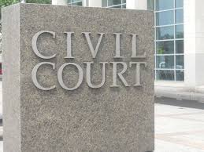
Invasion of Privacy
Intrusion on Seclusion – This is what you will be sued upon. Simply put this is the suit that will result for overreaching and over-snooping. The elements for this private cause of actions are:
1. the defendant intruded on the plaintiff’s solitude, seclusion, or private affairs;
2. the intrusion would be highly offensive to a reasonable person; AND
3. the plaintiff suffered some injury as a result.

Slide 17
Bedroom Cameras
Bedroom Cameras – In an effort to catch her cheating hubby, wife records husband’s sexual encounter with his girlfriend in the marital bedroom using a hidden camera. Court upholds invasion of privacy suit. A spouse by virtue of marriage relinquishes some of his privacy but, not all and not when recording happens without consent and an expectation is had. Clayton v. Richards, 47 S.W.3d 149 (Tex. App.–Texarkana 2001, pet. denied).

Slide 18
Open Windows I
Binoculars and Open Window – During neighbor dispute, neighbor parked in opposing driveway and used binoculars to look into kitchen at plaintiff resident. Court held that one cannot expect to be entitled to seclusion when standing directly in front of a large window with the blinds open or while outside. Vaughn v. Drennon, 202 S.W.3d 308 (Tex. App.–Tyler 2006, no pet.).

Slide 19
Open Windows II
Landowners sue neighbors for invasion of privacy for videotaping into their kitchen windows. The kitchen window faced the backyard, not a public street, and there was a six-foot-tall privacy fence separating the parties' properties. Taping occurred early one Saturday morning for only 10 second intervals while plaintiff was in kitchen eight months pregnant and wearing only her pajamas. Defendant was trying to document out of control dog as instructed by animal control. Court held that videotaping was invasion of privacy. Baugh v. Fleming, No. 03-08-00321-CV, 2009 Tex. App. LEXIS 9847 (Tex. App.—Austin 2009).

Slide 20
Things to Remember Wes’s Rules
Generally, CAN’T have Audio….unless there is NO expectation of privacy.
Outside, Restaurant, Screaming and Yelling.
Generally, CAN have video….where there is no reasonable expectation of privacy.
Where is that? Outside? Inside? Bathroom? Bedroom?

Slide 21
So, what about ring????

Slide 22
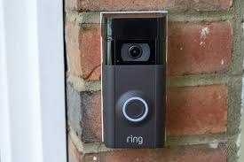
Doorbell-camera firm Ring has partnered with 400 police forces, extending surveillance concerns. (Washington Post 8-28-2019)
Allows the government to email through the app to the doorbell owner and request video.
Allows government to hand out the devices in exchange for program participation.
Still can pay someone to monitor the doorbell 24/7
Amazon has said that they will protect customer information unless search warrant / court order is issued.
57 Police Agencies in Texas are in Program

Slide 23
Participating Texas Amazon Partner Police Departments

Slide 24
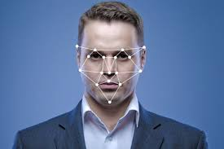
REKOGNITION
Amazon has also been developing facial recognition software named Rekognition. Used for TV, photo recognition, text recognition, movement tracking, etc.
Last year, Ring itself filed a patent application that would alert when a “suspicious” person was observed on camera.

Slide 25
Amazon Rekognition Software

Slide 26
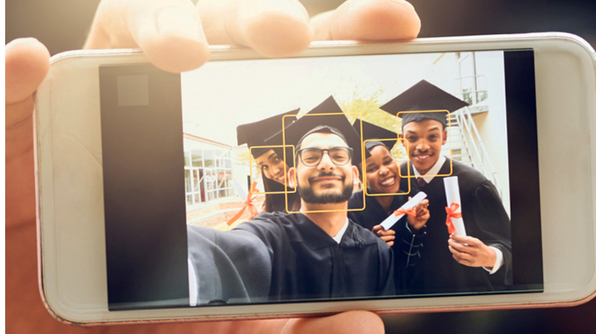
Recently updated the software to recognize a new emotion, “fear.”
.

Slide 27
Can you purchase the buyer’s photos and run them through an emotion database? Before and After showing?
Quite Possibly…. some companies moving to that possibility. But haven’t we been doing that in customer service for years?

