Slide 1
“Property Management – Avoid Getting Sued….and hacked”
Presented by
Barney Schwartz
CEO
Preferred Guardian Insurance

Slide 2
What you will learn?
Most common type of claims and ways to avoid being sued
E&O Insurance vs General Liability Insurance
How to protect your email from getting hacked

Slide 3
E&O Who/What is Covered
Who
Owner or Partner
An Employee
An Independent Contractor
What Occupations
Real Estate Agent/Broker
Property Management?
Stated on the Dec Page or Definition of Covered Occupations

Slide 4
General Liability vs. E&O
General Liability (Damage to Property or Injury)
Dog Bite
Slip and Fall
E&O
Fiduciary Responsibility
Rendering of Advice
Failing to recommend

Slide 5




Dog Bite – Scenario 1
If MLS Listing states, “Vicious Dog in Laundry Room, Do Not Open Door”, you open the door and the dog bites a potential buyer or renter. Is it an E&O Claim or a General Liability Claim?

Slide 6

Dog Bite – Scenario 2
MLS states, “Do Not Open Laundry Room Door Due to Vicious Dog”, you tell your client and they say, “All dogs love me!”. They open the door and are bit – is it an E&O or General Liability claim?

Slide 7
General Liability
Coverage is Entity Specific
Premium is based off of Revenue
Fees to Manage Properties
Rents which are passed through are not included
Landlord’s Insurance Policy will usually be primary
GL Company and E&O Companies may point fingers at each other
Requires E&O to be in place
Agent Owned Property Management is usually excluded

Slide 8
Fiduciary Duty
Your Duty as an Agent
Inform your clients and provide information
Make suggestions and recommendations
Your Duty is NOT, making decisions for your clients
Provide them with the information so they can make informed pro/con decisions

Slide 9
What to do when a E&O claim or TREC Complaint surfaces or you receive a Subpoena Request?
Report the claim promptly to your insurance broker or insurance company
Do not try and settle on your own even if damages are under your deductible
Do not hire an attorney as they may not be approved by the insurance company
Report the Subpoena request to the insurance company

Slide 10
Most Common Types of Claims
Property Maintenance
Timely handling of repairs
Failure to perform repairs
Misrepresentation of Zoning
Permission to Rent
Management of Tenant Selection
Screening
Failure to locate Renters
Background checks
Handling and collection/return of deposits
Failure to maintain accurate rent receipts and records
Discrimination

Slide 11
Do what you do best!
Legal Advice
General Contractor
Business Broker
Residential Property Management, its your call
“Force the client to make decisions”

Slide 12
Agent Owned Properties
Agent owned is typically defined as 10% or greater ownership
Most Insurance Companies will not provide coverage for Agent Owned Property Management
Most litigation is between Property Manager and the Landlord and with agent owned they would be suing themselves in most cases

Slide 13
Contractor Management and Selection
Insured
General Liability
Workers Compensation
Bonded
Background Checked
Maintain Great Records
Repairs
Warranty
Avoid saying “things have been repaired.” Provide receipts

Slide 14
Confirm and Store Info
Please confirm that you have received
Create the information hub (online)
Text
Social Media
Email
Mail
Voicemail

Slide 15
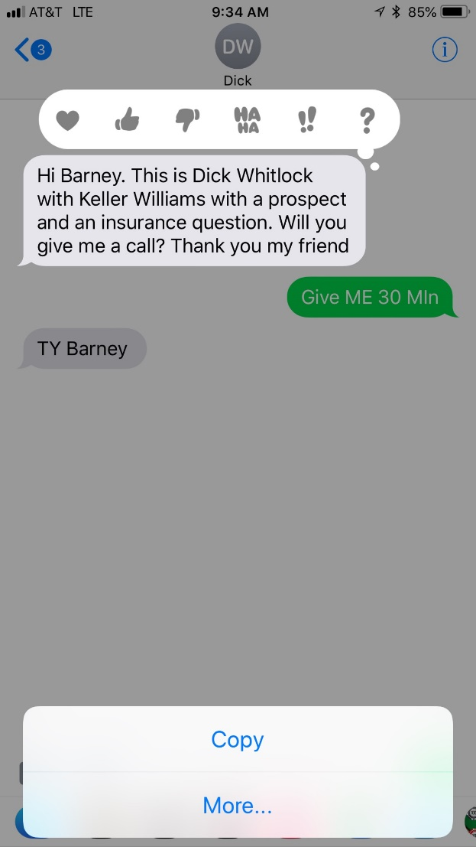
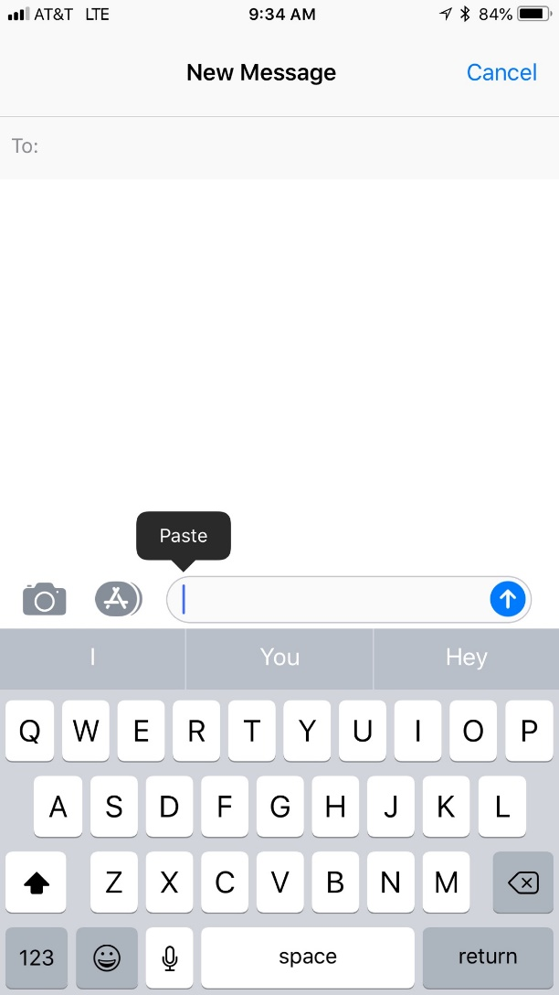
Forwarding Text Message

Slide 16
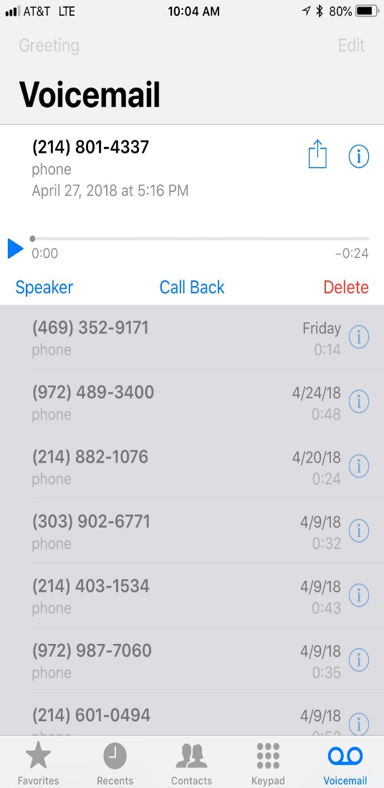
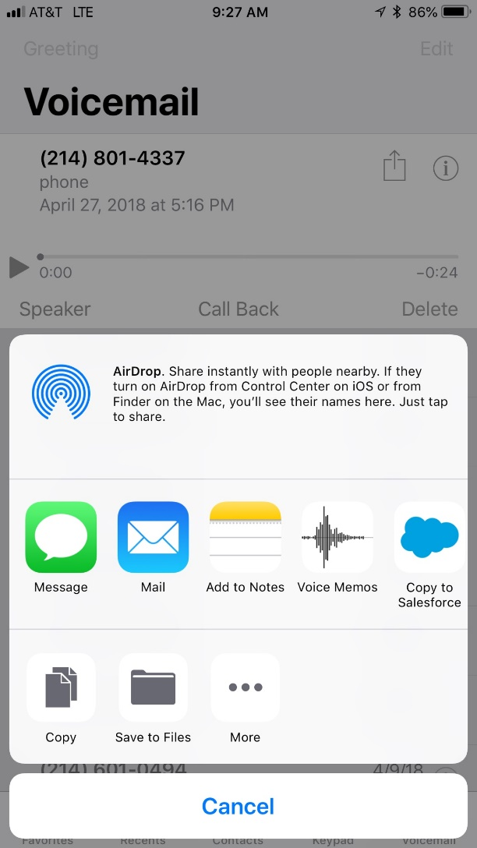
Fowarding Voicemail to Email

Slide 17
Claim Scenario
“The Hack”

Slide 18
The Hack
Password was discovered on a Gmail Account
Password was changed
Hacker read through email looking for cash buyers
Sent the Cash Buyer wiring instructions to fictitious account
$50,000 wired and in 20 minutes dispersed into 15 international bank accounts

Slide 19
Phishing
Be aware of Phishing Schemes
Comes from someone you know.
Comes from someone who has sent you an email before.
Is something you were expecting.
Does not look odd, but has hidden misspelling or characters.
From Z!llow barney@preferredguardian.com
Click Here for your Real Estate Referral.
How to Address
Hit reply and ask, did you mean to send this email?
Hover mouse over the link
Look at sender carefully – Zillow vs. Z!llow

Slide 20
How can Cyber Crimes Impact a Property Manager
Theft of Client Personal Information
PII – As little as two pieces of info
Name
Date of Birth
SS#, Drivers License Number
Encrypting Information on your computer – Ransom Virus
Locking up your computer – Down Time
Hacking into Email and providing wiring instructions to Cash Buyers or Renters
Hack into a Landlord Computer and change wiring instructions - confirm

Slide 21
Theft of Client Information
Over 1/3 of all Cyber claims happen to companies under 100 people
Need to determine who was impacted
Hiring of Computer Forensics
Offer Credit Monitoring for 1-2 years

Slide 22
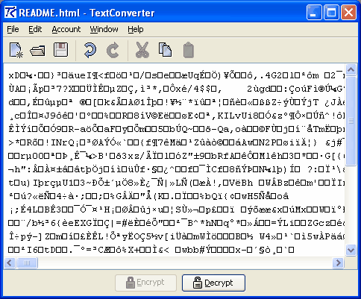
Ransom Virus
Word, Excel, PDF’s look like below
Files are converted back after paying a Ransom
Was a tracking device left on computer?

Slide 23
Password
Fast App – Free App
Stores Passwords with a single password
Lose your computer and login to shut down stored passwords
Double Authenticates Access to stored Password

Slide 24
Email Authentication
Gmail/Hotmail/Yahoo
Add your phone number under Security Checkup
Signing into Google, 2 step verification
Add Text Message or Phone Call.
Yahoo Hotmail and Facebook have this as well
Facebook

Slide 25
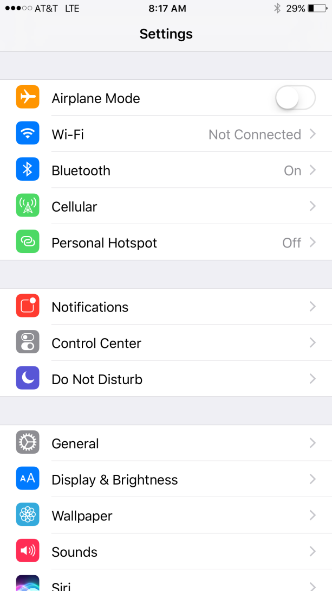
Use Phone for Hotspot

Slide 26
Preventative Methods
Do not click on links that will allow password capture
Password System – Last Pass?
Password Complexity with Cell Phone Verification
Do not use public Wifi

Slide 27
Maintain Records
Create a Central Hub
Dropbox – 2GB Free
Google Drive – 5GB Free
Icloud – 5GB Free

Slide 28
Computer Backup
Back Up Data
Mozy
50gb $5.99
125gb $9.99
Carbonite
$69yr Unlimited
$99 with Mirror Image

Slide 29
Tenant Selection Criteria
Use a Selection Form
Names and Numbers of Previous Landlords
Monthly Income Requirements
Deposit within 24hrs
Credit and Criminal Reports Obtained
Pet Requirements (Excluded Breeds)

Slide 30
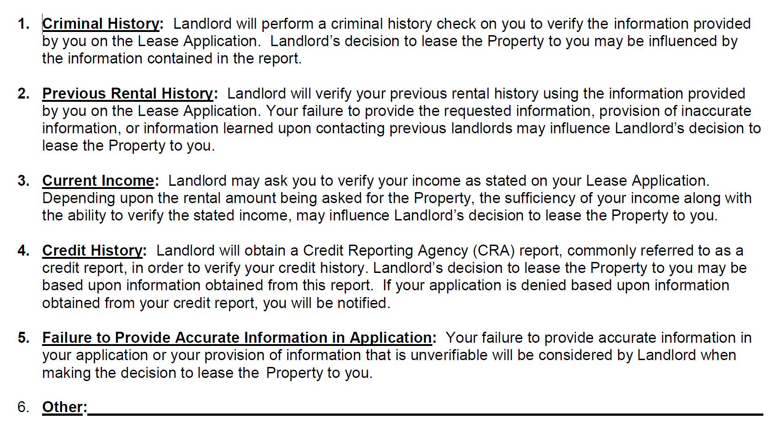
TAR’s Model Tenant Selection Criteria Form
For educational use only.

Slide 31




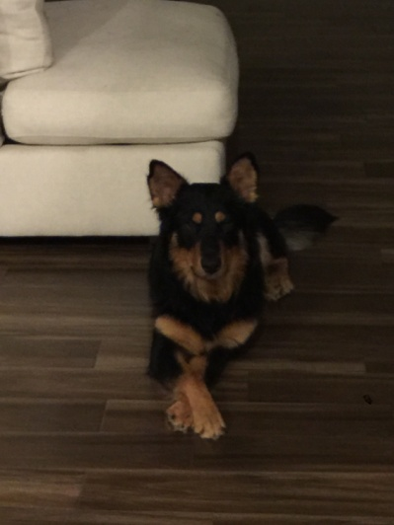

Bad Dogs

Slide 32
Service Animals
Emotional support animals, comfort animals, and therapy dogs are not service animals under Title II and Title III of the ADA. ...
Psychiatric Service Dog is a dog that has been trained to perform tasks that assist individuals with disabilities to detect the onset of psychiatric episodes and lessen their effects
Emotional support animals require a letter from a Doctor or therapist – Can obtain online
Cannot ask if the Animal is an Emotional Support Animal
Cannot require additional security deposit
Require a consistent Pet Deposit?

Slide 33
Insurance for Rental Properties
Home should be insured on a Dwelling Fire Policy or a Landlord Policy and not a Homeowner Policy.
Make sure the property owner carries liability limits of at least $300,000, but preferably higher. Higher limits are relatively inexpensive. This will in most cases be the first line of defense
The Landlord should also make sure the policy covers loss of rents
Property Manager should be added as an “Additional Interest” so you are notified if the policy has been cancelled

Slide 34
Vacant Home
Homes are considered vacant after 30 or 60 days
Coverage is either reduced or voided by most insurance companies
Increase exposure to Theft and Vandalism
No way to mitigate a water claim

Slide 35
Tips to Avoid Lawsuits
Maintain Good Communication
Be liked
Avoid Giving False Expectations
Have the Client Make the Hard Decisions
Document your Advice
Avoid the difficult and unethical client
Client Interests First

Slide 36

Questions?

Slide 37

.
Barney Schwartz
CEO
Barney@Preferredguardian.com
972-331-5100 - Office
972-741-2569- Cell

