Slide 1
Littlefield: a city in crisis
Jef Conn, CCIM Coldwell Banker Commercial Lubbock, Texas

Slide 2
objectives
Learn About the Littlefield Project, winner of the 2015 Texas Assn. of Realtors William C Jennings Commercial Transaction of The Year
Understand the complexity of this commercial transaction
Realize the Challenges That Had To Be Overcome
Detail the process from beginning to end
City Interest
Question & Answer - End

Slide 3
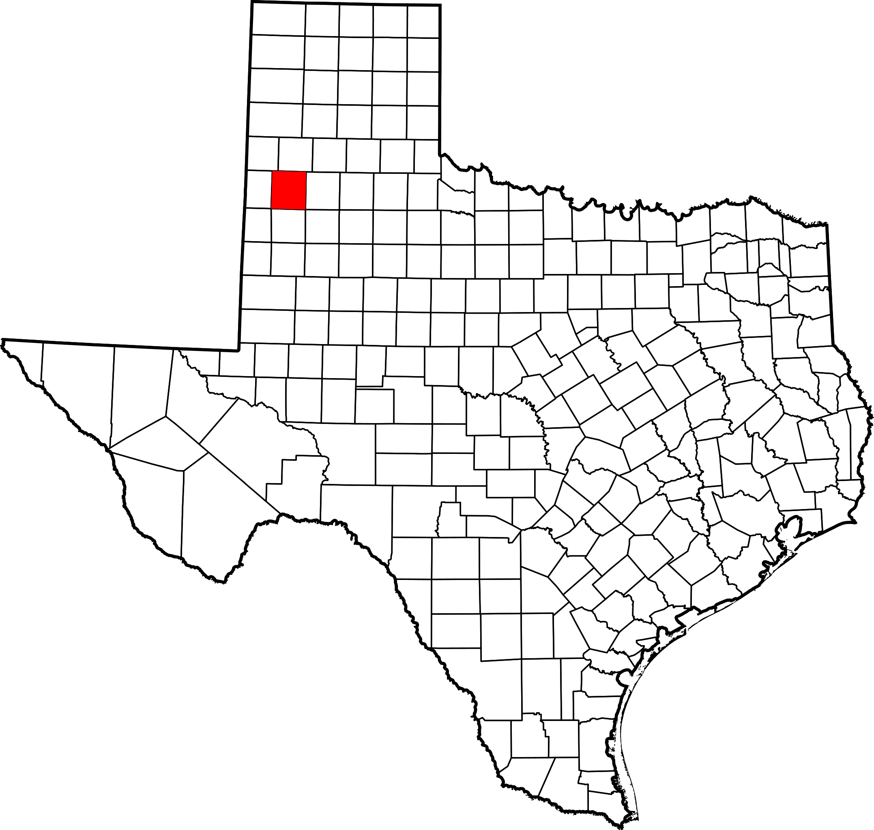
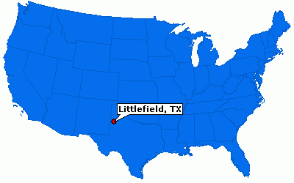
Where exactly is Littlefield?

Slide 4
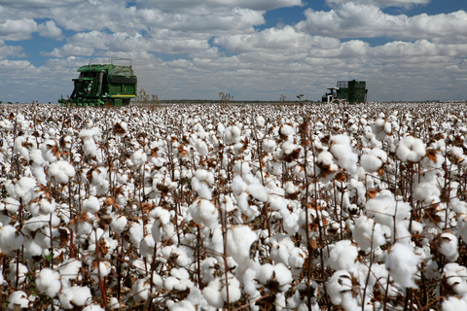

Slide 5
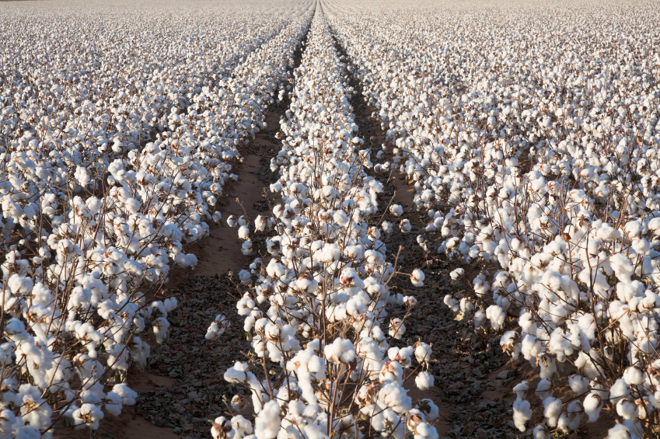

Slide 6
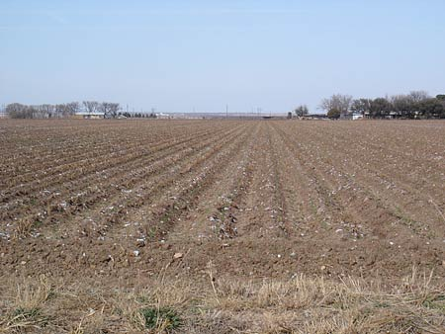

Slide 7
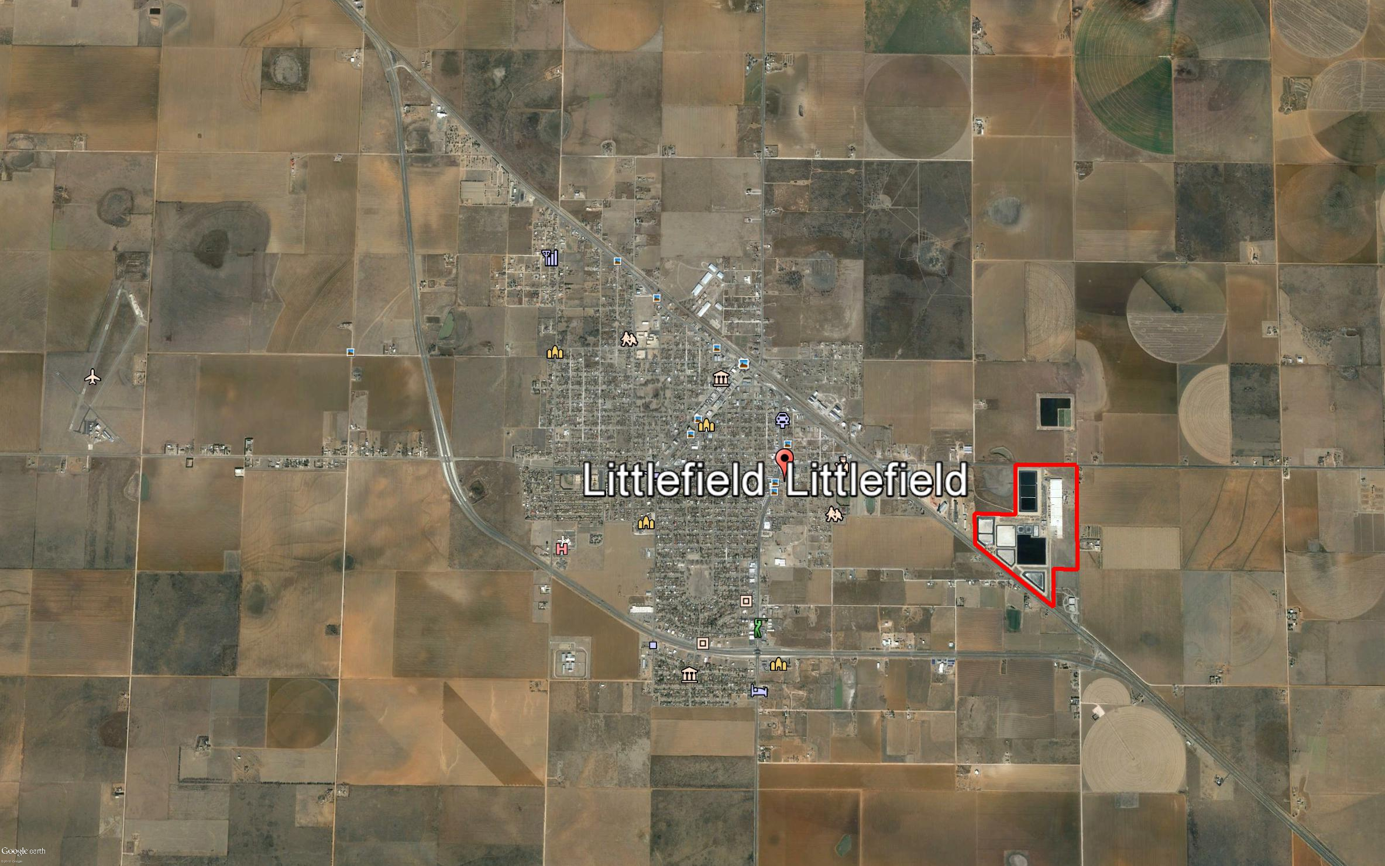

Slide 8
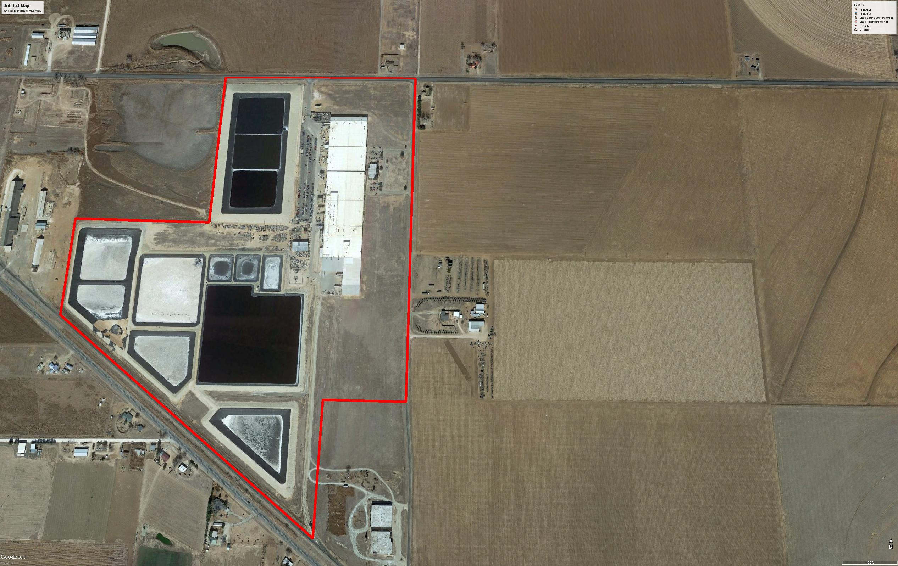
475,000 Sq Ft
155 Acres
8 Water Retention Ponds
Specialized Equipment

Slide 9
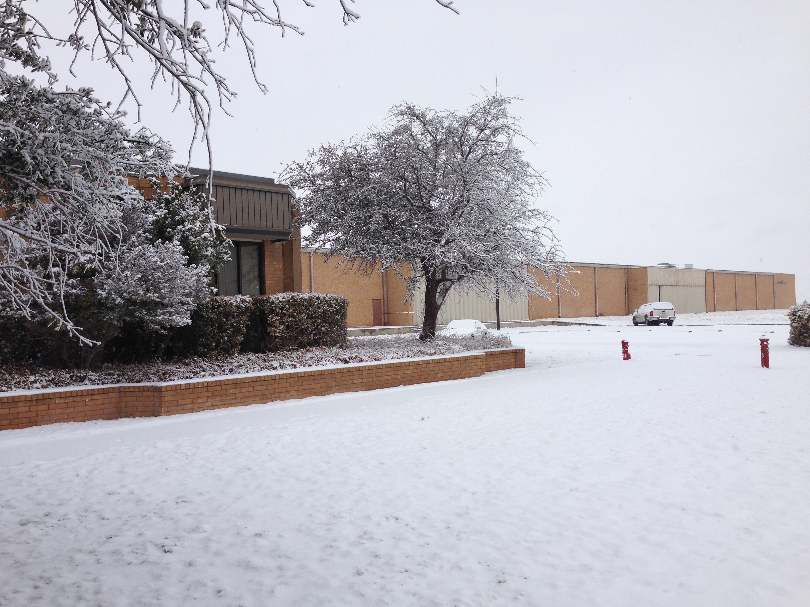

Slide 10
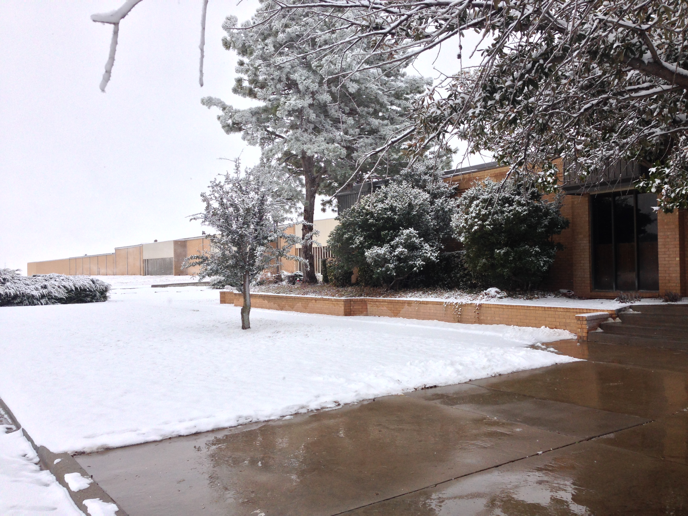

Slide 11
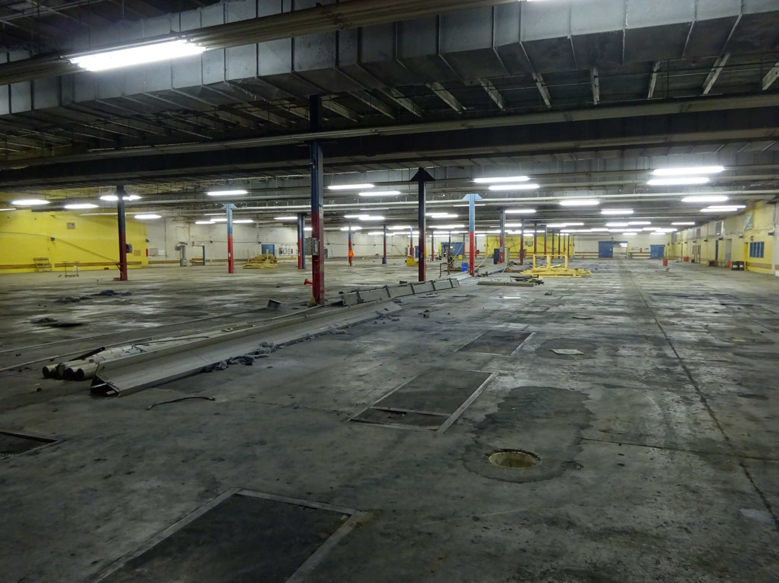

Slide 12
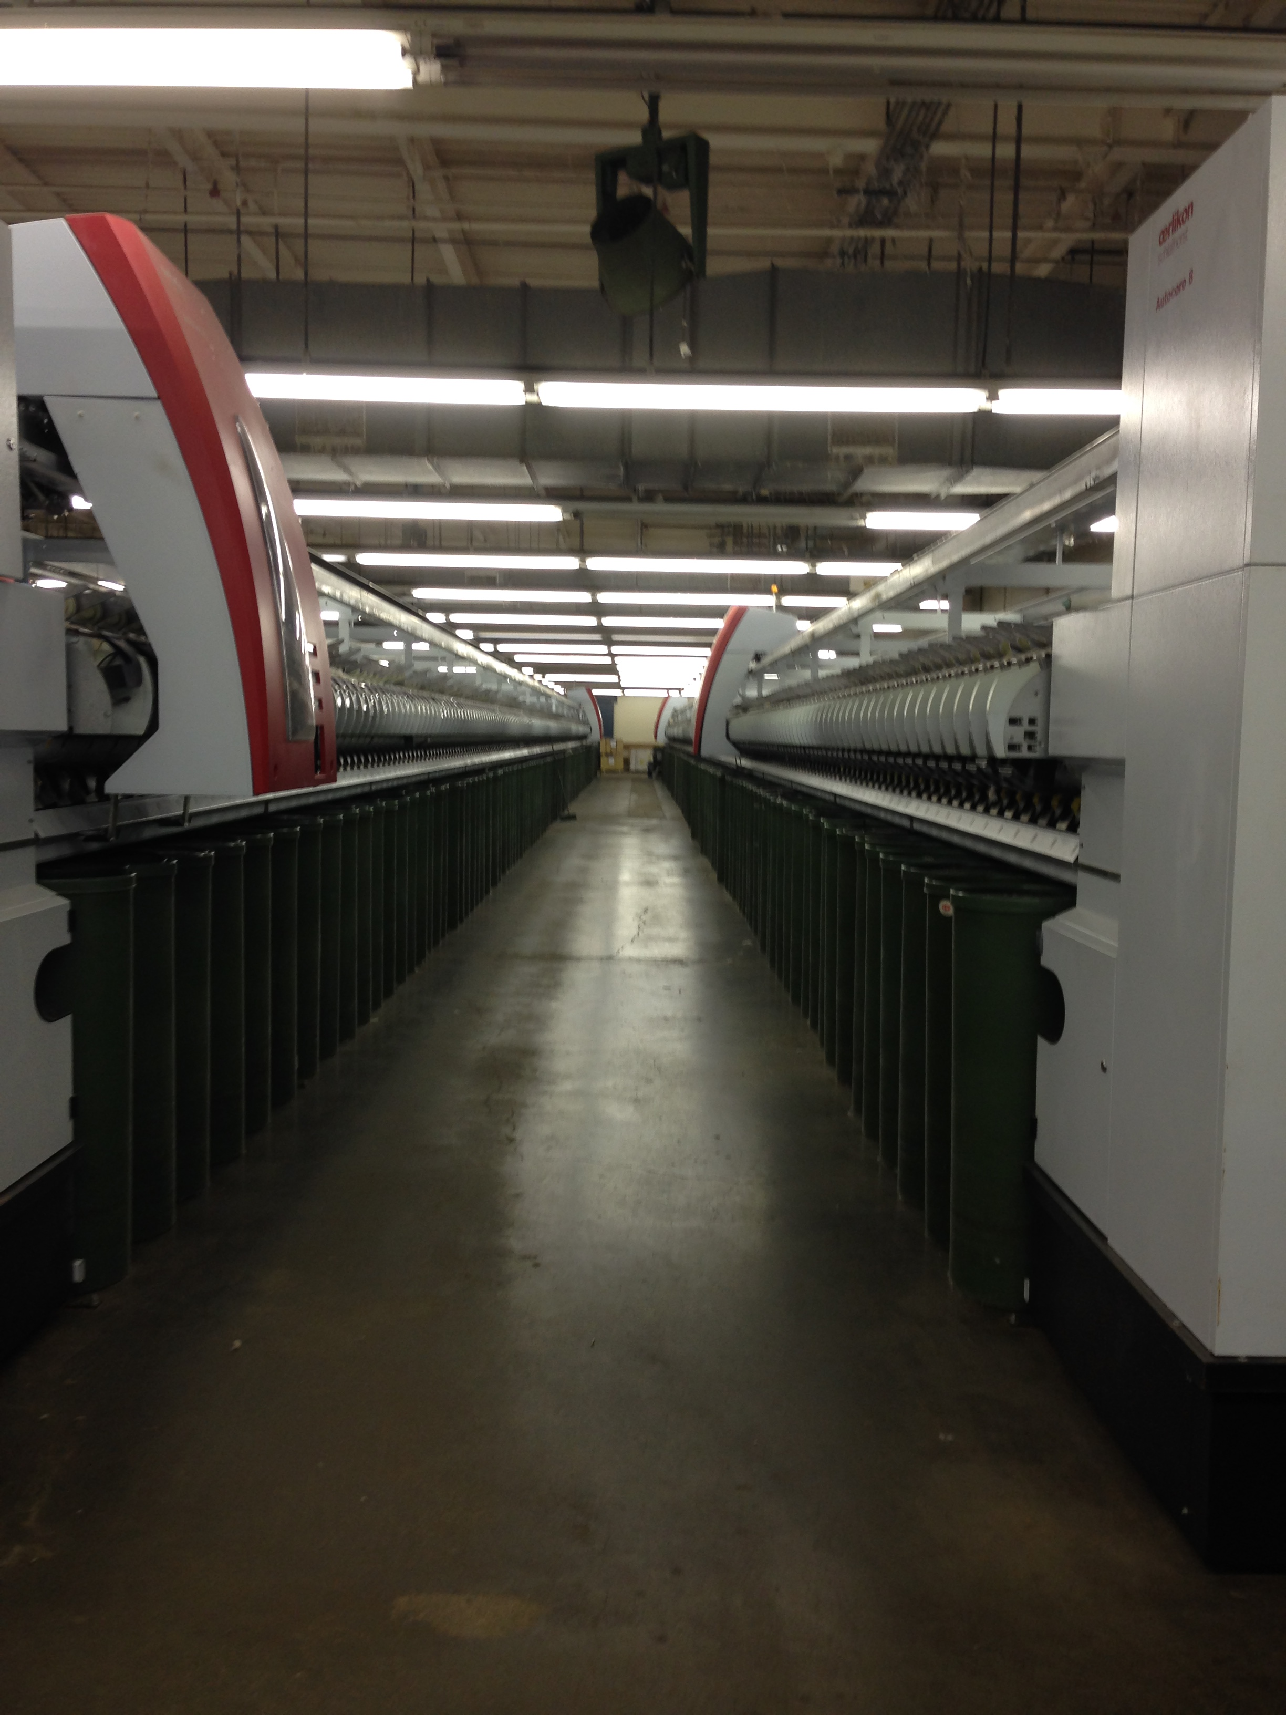
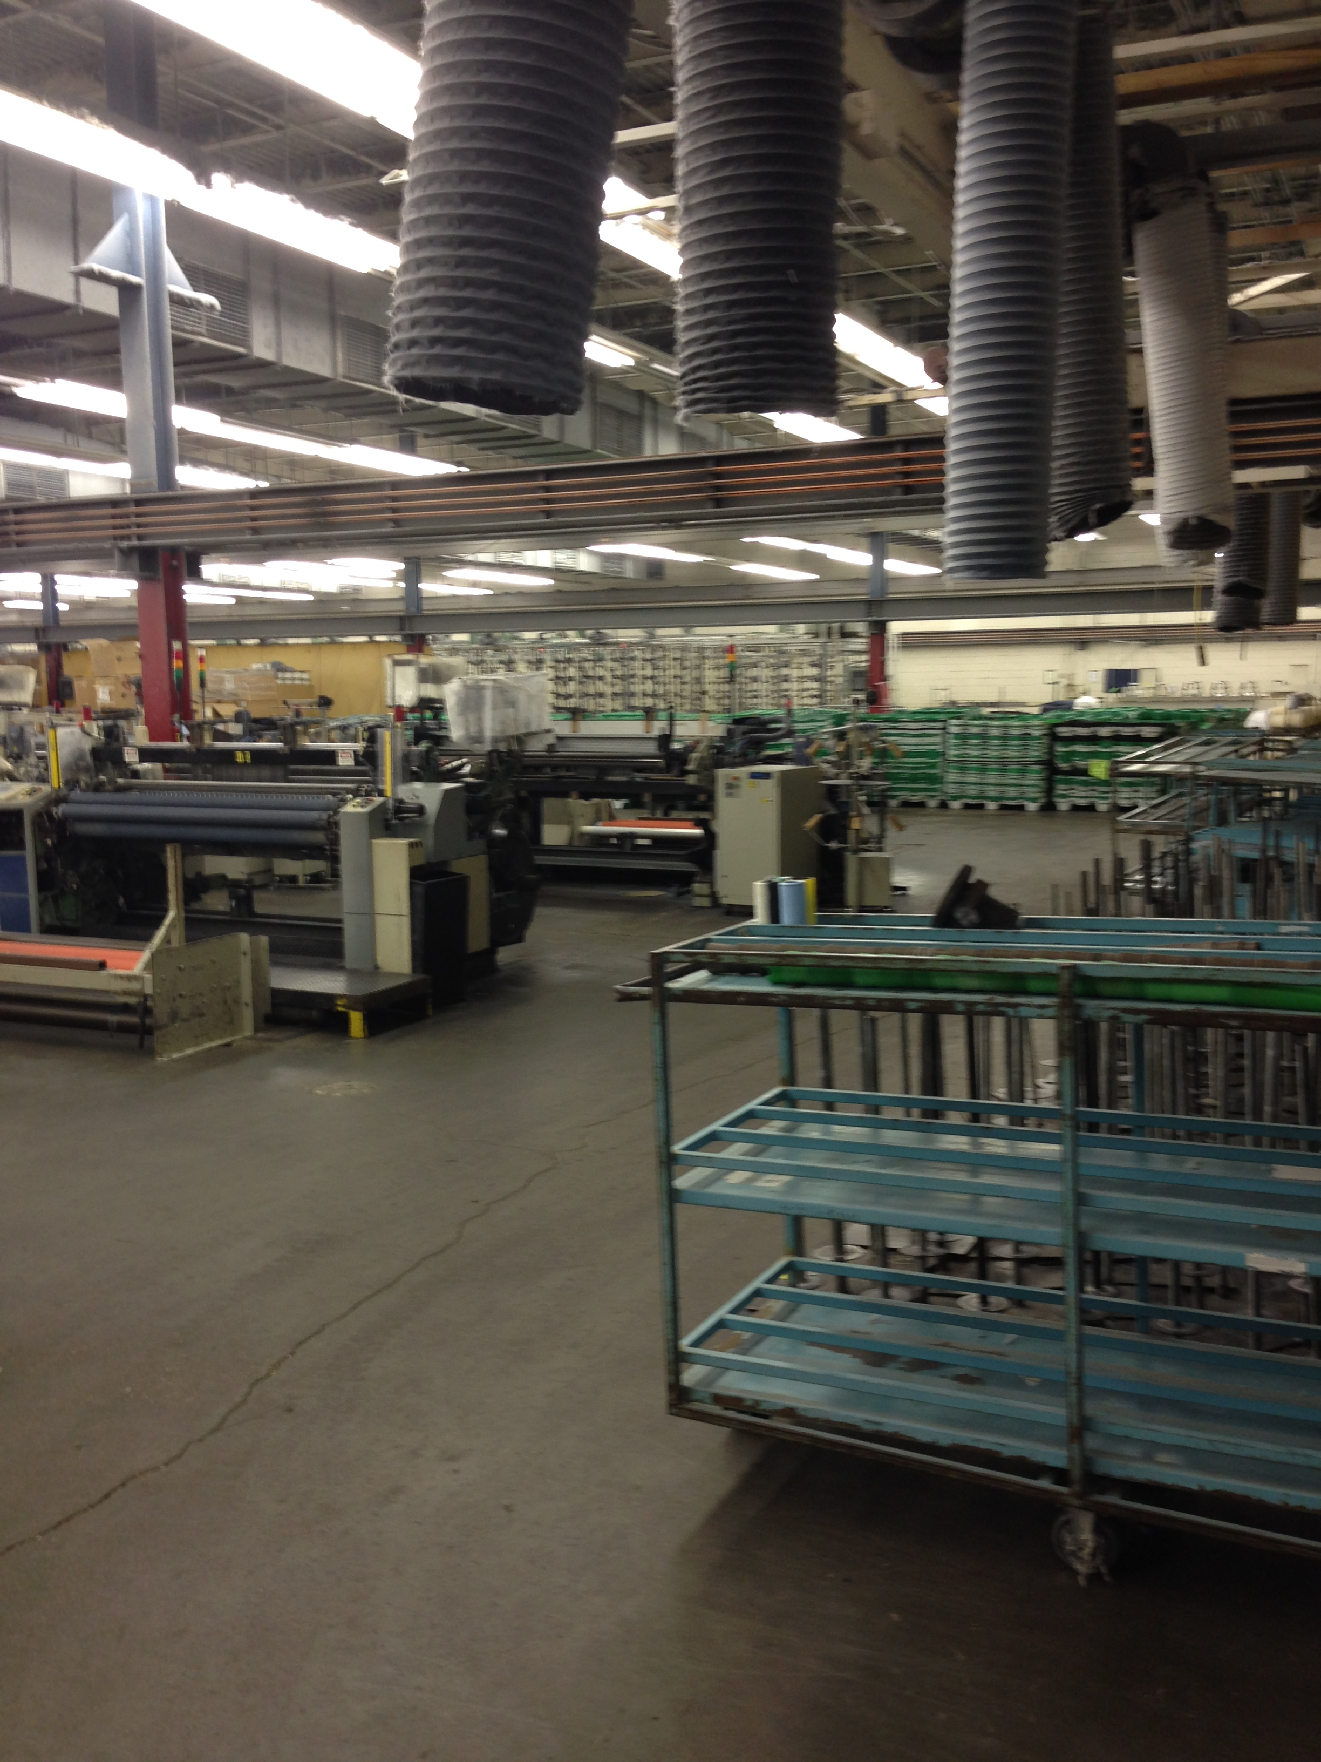

Slide 13
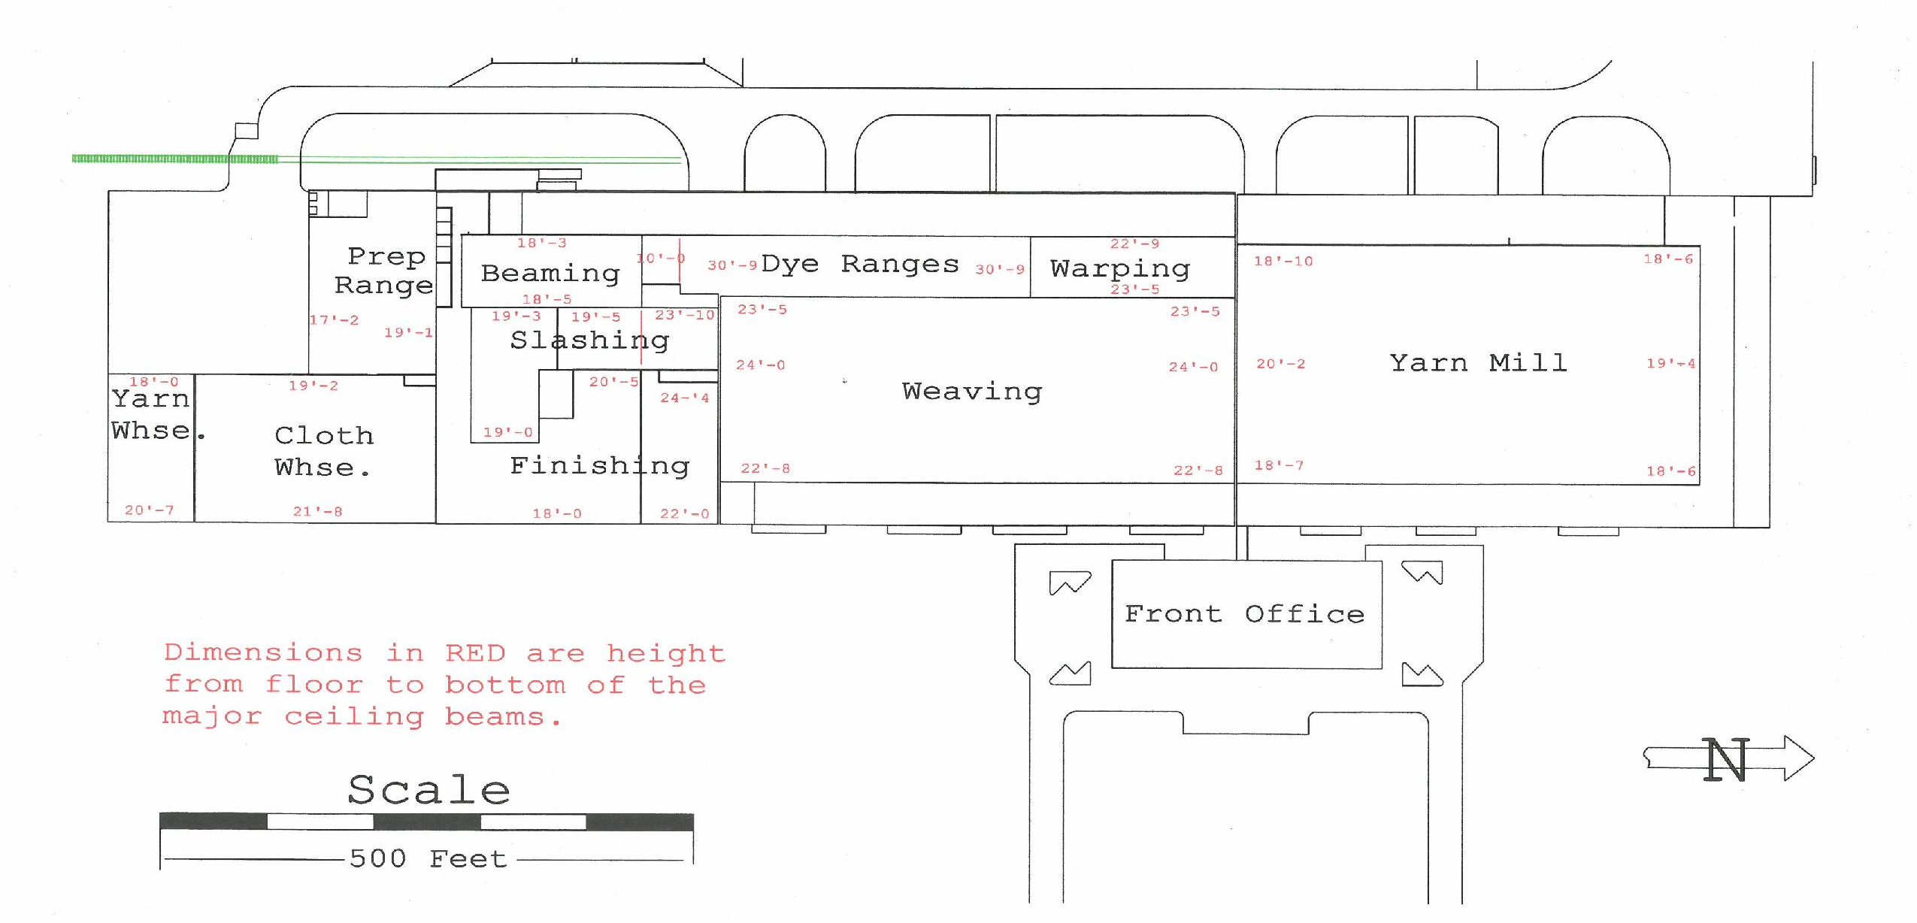

Slide 14
clients
6500
Seller – Private Equity Firm – New York City
Buyer – Multi-Billion Dollar Dairy Conglomerate
City of Littlefield
Former Denim Factory Employees
City Council, Mayor, City Manager
Littlefield Newspaper

Slide 15
What Did this Sale mean to littlefield?
Everything.

Slide 16
Process

Slide 18
Who will buy this property?
Economic Development – State, Local
Large Companies in Area
Transportation
Distribution
Seller’s Contacts – Private Equity World

Slide 19
Buyer Profile
Multi-Billion Dollar Conglomerate
Looking To Expand in West Texas to be close to cheese factory in Artesia, NM
Needed Facility with Land
Dehydrated Milk Facility – removing water from milk to make powder
Fields to irrigate excess water a must

Slide 21
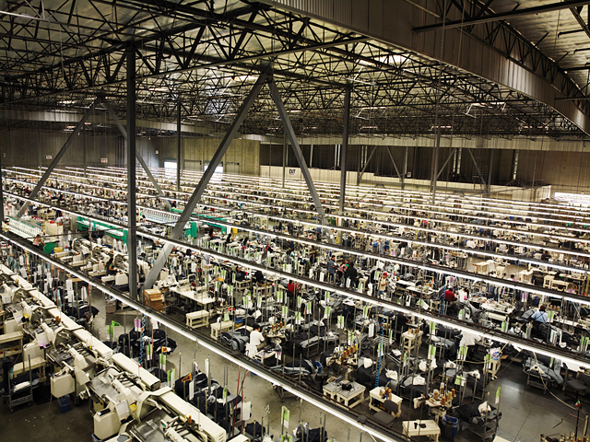
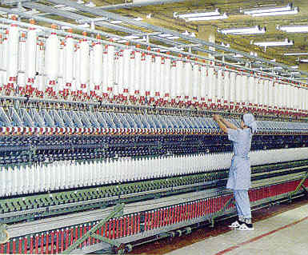
Equipment

Slide 22
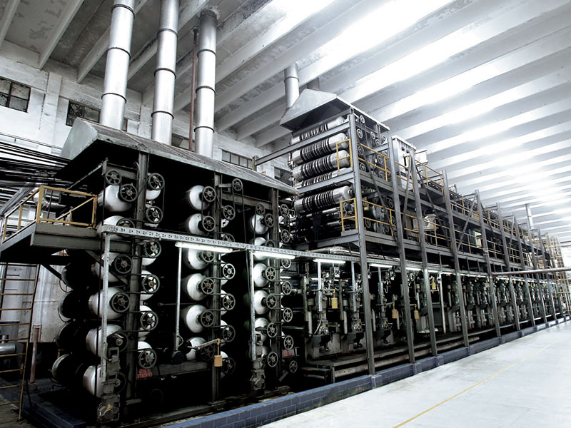
Environmental Issues
Removing Equipment
2 Large Pits 25 x 100
4 Feet Deep
Sludge – 75 years worth of dyes built up
Could Not Close Until Cleaned Up

Slide 23
Monitoring Clean Up For Buyers & Seller
1-2 Trips To Property Every Week for 11 months
Daily Phone Calls & Emails with Buyers & Sellers
Extend Contract. Repeat.
Lawyers.

Slide 24
Buyers Building $350,000,000 dehydrated milk facility on excess land
Using original building for storage/inventory
160 truck loads of milk, daily.
160 jobs created.
City saved from bankruptcy.

Slide 26
William C Jennings Award

Slide 27
Questions?
Jef Conn, CCIM
Jconn@CBCWorldwide.com
806-784-3216

