Slide 1


Slide 2


INCENTIVES & FINANCING
Texas invests in its future by offering competitive incentives to companies that create jobs and drive innovation.
The following incentives are the most commonly applied offerings.
COMMUNITY INCENTIVES
Texas and local communities offer a variety of tax incentives and innovative solutions for businesses expanding in or relocating to Texas. The following incentives are the most commonly applied offerings.
Local funding to business-related infrastructure
and recruitment, equipment, land and economic development purposes.
Property tax abatements
Permitting fee waivers
Local cash grants
TAX INCENTIVES
Texas Enterprise Zone Prog ram: State sales and use tax refunds to promote job creation and investment that will assist economically distressed areas of the state.
Manufacturing Exemptions: State sales and use tax exemptions for tangible property, natural gas and electricity.
Value Limitation and Tax Credits (Texas Economic Development Act): An appraised ten-year limitation to the local school district maintenance and operations tax portion of the property tax.
Freeport Exemptions: Tax exemption for certain goods that enter and leave Texas within 175 days.
Pollution Control Equipment Incentive: Tax exemption for property that is for pollution control purposes.
Renewable Energ y Incentives: Tax exemptions and deductions for solar, wind, ethanol and biodiesel.
Defense Economic Readjustment Zone Program: A tax refund program for business recruitment and job creation in adversely impacted defense-dependent communities.
Research & Development Tax Credit: Gives companies a choice between a franchise tax credit and a sales tax exemption for materials, software, and equipment used for R&D purposes.
Data Center Tax Incentives: Allows qualifying data centers to receive sales and use tax exemption on tangible personal property.
Business Relocation Tax Deduction: Allows a company relocating its headquarters from out of state to Texas to deduct relocation and moving expenses from their margin when calculating franchise tax liability.

Slide 3
INCENTIVES & FINANCING
GRANTS
From public infrastructure projects in non-entitlement communities, to cancer research and laboratory facility construction, several types of grants are available to Texas communities and businesses.
Texas Enterprise Fund (TEF): The Texas Enterprise Fund (TEF) is one of the nation’s largest “deal closing” funds created to attract businesses and new jobs to Texas. Since the program’s inception, the TEF has awarded approximately $595 million to companies that have committed to an expansion or relocation in Texas.
Skills Development Fund: An innovative program created to assist Texas public community and technical colleges finance customized job training for their local businesses. Grants are provided to help companies and labor unions form partnerships with local community colleges and technical schools to provide custom job training.
Self-Sufficiency Fund: A job-training program that is specifically designed for individuals that receive Temporary Assistance for Needy Families (TANF). The program links the business community with local educational institutions and is administered by the Texas Workforce Commission. The goal of the Fund is to assist TANF recipients become independent of government financial assistance.
Governor’s University Research Initiative (GURI): In 2015, Governor Greg Abbott passed legislation to create Governor’s University Research Initiative (GURI) with the goal to bring the best and brightest distinguished researchers in the world to Texas. GURI is a matching grant program with $40 million allocated to assist eligible institutions of higher education in recruiting distinguished researchers.
Texas Capital Fund Infrastructure Development and Real Estate Programs (INFRA/RE): Economic development tools designed to provide financial resources to non-entitlement communities . Funds from the program must be utilized for public infrastructure projects or real estate development needed to assist a business that commits to create and/or retain permanent jobs, primarily for low and moderate income persons.
Cancer Prevention & Research General Obligation Bonds: Funding opportunities for promising cancer research and prevention programs.
The Defense Economic Adjustment Assistance Grant Program (DEAAG): A job creation grant program designed to assist defense communities impacted by Base Realignment and Closure (BRAC) activity, or reduction or termination of defense contracts. DEAAG funding is available to local municipalities, counties, defense base development authority, junior college districts and Texas State Technical College campuses, and regional planning commissions representing these communities.
The Texas Enterprise
Fund is the largest
deal- closing fund
of it’s kind in the
United States.

Slide 4
INCENTIVES & FINANCING
FINANCING
Texas is committed to providing and facilitating funding for companies and communities with expansion and relocation projects in the state. Asset-based loans for companies, leveraged loans to communities and tax-exempt bonds are just a few means of obtaining the capital necessary for a successful project.
The Texas Product Development and Small Business Incubator Fund (PDSBI) is a revolving loan program financed through original bond issuances. The primary objective of the program is to aid in the development, production and commercialization of new or improved products and to foster and stimulate small business in the state.
The Texas Leverage Fund (TLF) provides a source of financing to communities that have adopted an economic development sales tax. Communities may leverage future sales tax revenues to expand economic development through business expansions, business recruitment and exporting.
The State of Texas Industrial Revenue Bond Program (IRB) provides tax-exempt or taxable financing for eligible industrial or manufacturing projects
The Texas Military Value Revolving Loan Fund (TMVRLF) assists defense communities in enhancing the military value of a military facility in their area. The fund can help defense communities develop job-creating projects and construct infrastructure to accommodate new or expanded military missions resulting from a base realignment and closure decision that occurred in 2005 or later.
Certified Capital Company (CAPCO) is a private government-sponsored venture capital company formed to increase the availability of growth capital for small businesses located in Texas. The program is also intended to stimulate job creation in Texas by requiring supported businesses to have at least 80 percent of payroll/manpower located within Texas. It's one way small businesses in Texas receive venture capital.
The Capital Access Program was established to increase the availability of financing for businesses and nonprofit organizations that face barriers in accessing capital or fall outside the guidelines of conventional lending. Use of proceeds may include working capital or the purchase, construction, or lease of capital assets, which include buildings and equipment.
The Texas Enterprise
Fund is the largest
deal- closing fund
of it’s kind in the
United States.

Slide 5

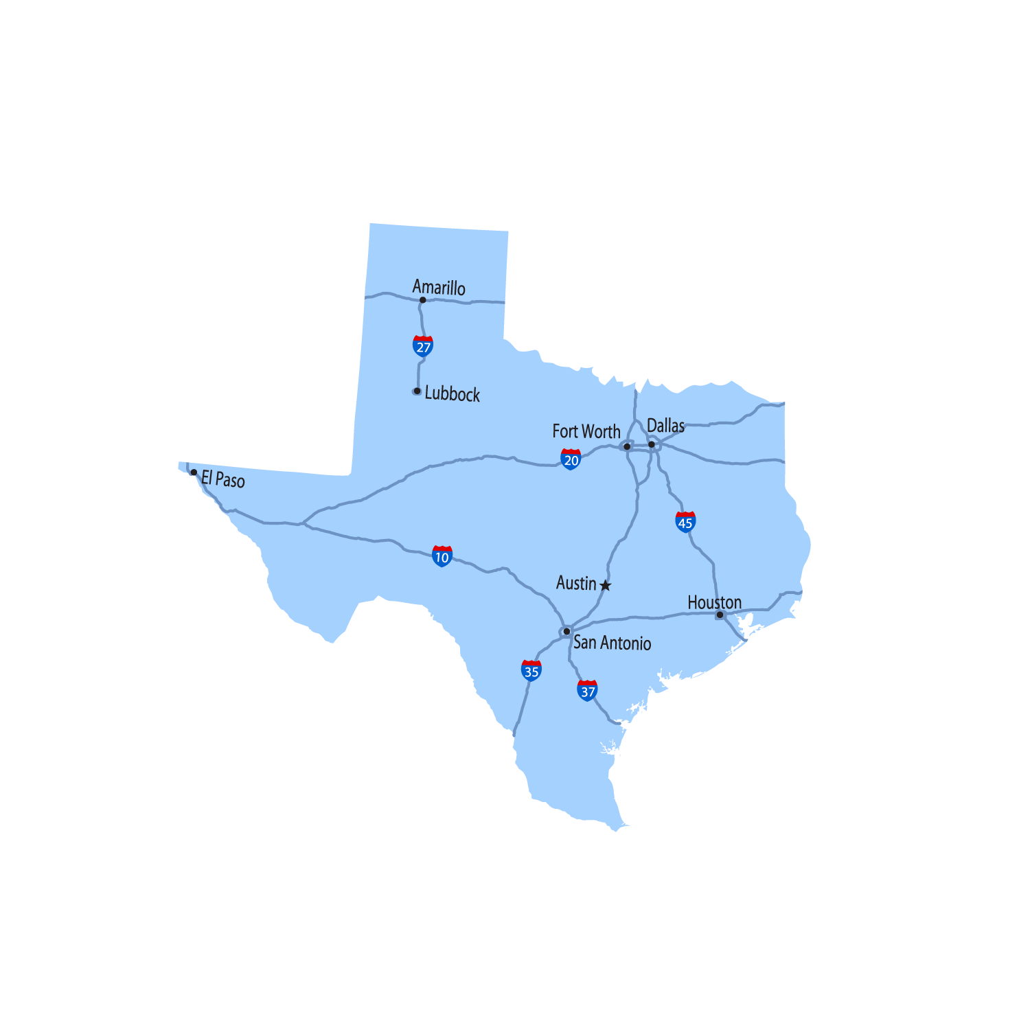
Texas Enterprise Fund (TEF)
The Texas Enterprise Fund (TEF), the largest deal-closing fund of its kind in the nation, continues to attract business and jobs to Texas by filling the critical gaps in funding that can limit relocation or expansion.
The TEF is a cash grant used for projects that offer significant job creation & capital investment where a single Texas site is competing with another viable out-of-state option.
The Texas Enterprise Fund has:
awarded more than $600 million,
announced more than 81,800 new jobs, and generated over $26.9 billion in capital investment.

Slide 6
TEF Eligibility
Competition out of state.
Significant job creation – 75 jobs in urban areas or more than 25 in rural areas.
High-paying jobs – above the average wage of the county.
Significant capital investment - $1M+
Significant rate of return on public dollars invested.
Community involvement.
Well-established, financially sound business in an advanced industry.
Unanimous approval from the Governor, Lt. Governor and Speaker of the House.

Slide 7

TEF Process & Timeline
Day 1
Application Intake
2-3 Weeks
Due Diligence
30-44 Days
Trustee Review
6-8 Weeks Average Timeline from Completed Application

Slide 8
TEF Agreement
TEF Agreement
Award amount ranges from $1k - $10k per new job.
Award amount depends on wages, job ramp up, capital investment and return on investment to the State.
Disbursements
Granted after new jobs have been created and verified.
Must maintain Baseline jobs throughout life of the contract.
Clawbacks, amendments and terminations.

Slide 9

Texas Enterprise Zone (TZP)
The Texas Enterprise Zone Program (TZP), is an economic development tool for local communities to partner with the State of Texas to promote job creation and significant private investment that will assist economically distressed areas of the state. Approved projects are eligible to apply for state sales and use tax refunds on qualified expenditures. The level and amount of refund is related to the capital investment and jobs created at the qualified business site. 105 Designations, statewide, per biennium.

Slide 10
EZP Eligibility
A local community must nominate a company as an Enterprise Project to be eligible for EZP.
Communities must have local incentives to offer the project for EZP qualification. Typical local incentives include tax abatement, tax increment financing, and one-stop permitting.
Communities may nominate projects for a designation period up to five years. Employment and capital investment commitments must be made and implemented within this timeframe.
Projects may be physically located in or outside of an Enterprise Zone.
  If located within a zone, the company commits that at least 25 percent of their new employees will meet economically disadvantaged, enterprise zone residence requirements, or veterans.
  If located outside of a zone, the company commits that at least 35 percent of their new employees will meet economically disadvantaged, enterprise zone residency requirements, or veterans.
Projects must meet or exceed county weekly wage averages to be eligible.

Slide 11
EZP Benefits

Slide 12

Office of the Governor
Economic Development & Tourism Division
P.O. Box 12428 | Austin, Texas 78711
512.936.0100 | Shane.Saum@gov.texas.gov
www.BusinessInTexas.com

