Slide 1
ATLAS 14
Overview and Update
Presented By: Mark Ramseur, Managing Principal, Central Texas
For: Texas Realtors, Webinar
July 16, 2019

Slide 2
Agenda
ATLAS 14 Overview
Central Texas/Austin Update
Impact Outside Central Texas (San Antonio & Houston)
Questions to ask about property/development site

Slide 3
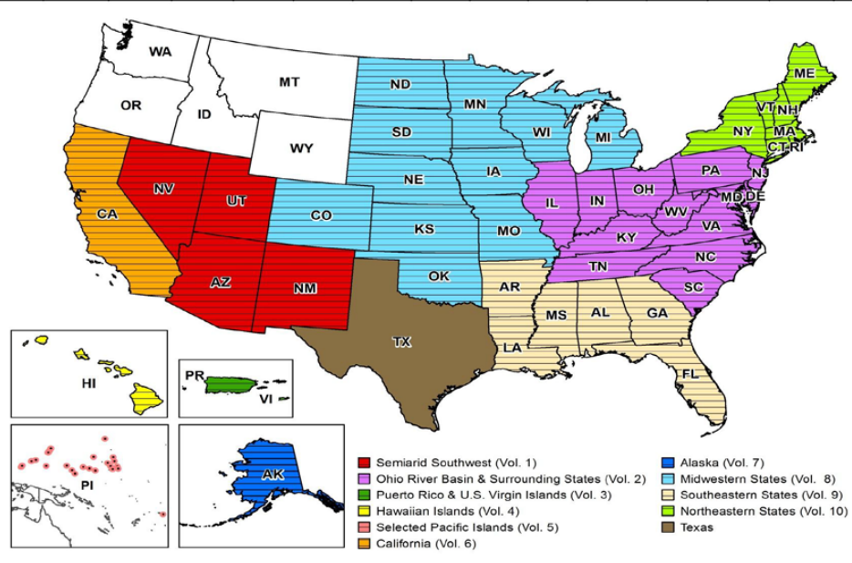
ATLAS 14 Background
Volume 11 (Texas)
Nationwide study of rainfall intensities
Partners
Federal National Weather Service, U.S. Army Corps of Engineers, Federal Highway Administration
State/Local TxDOT, Harris County Flood Control District, City of Austin, et al.

Slide 4
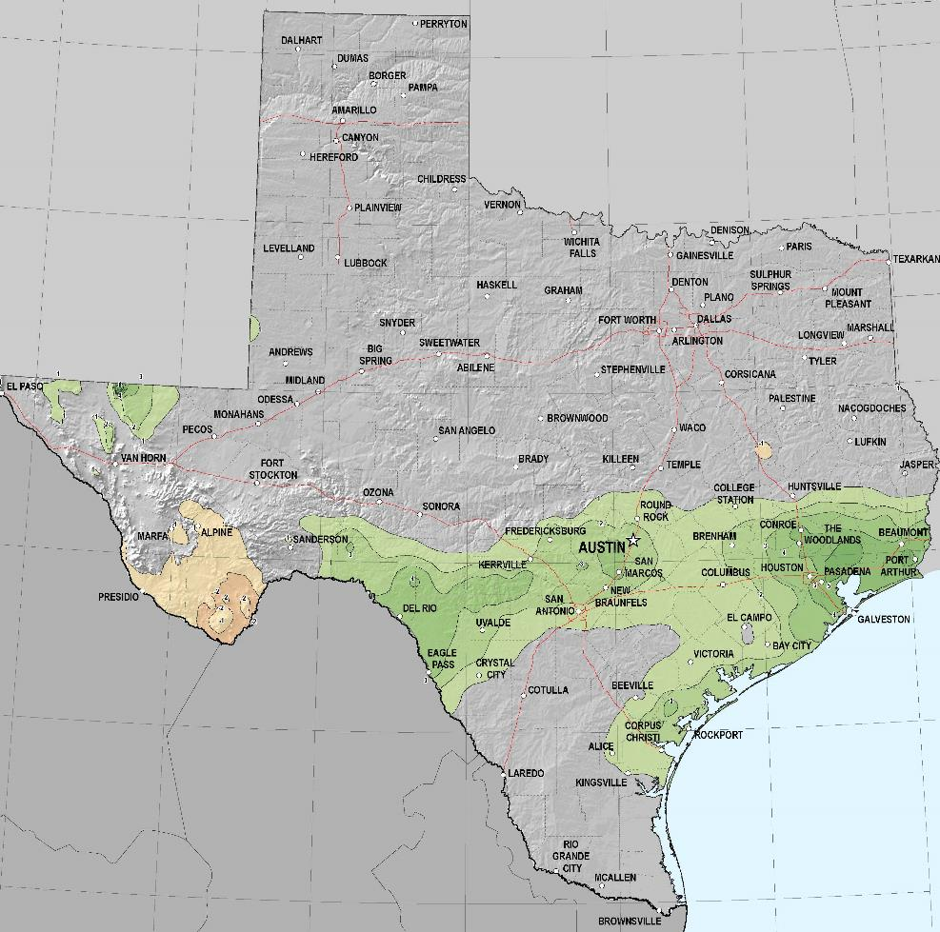
ATLAS 14 Rainfall Changes – Texas (Vol. 11)
Statewide examination of historic rainfall data
Adds data from 1961 – 2017 (3,900 rain gages)
Data released in October 2018
Colorado River watershed not significantly impacted
Central Texas and East Texas have largest impacts (100 Year Rainfall)

Slide 5
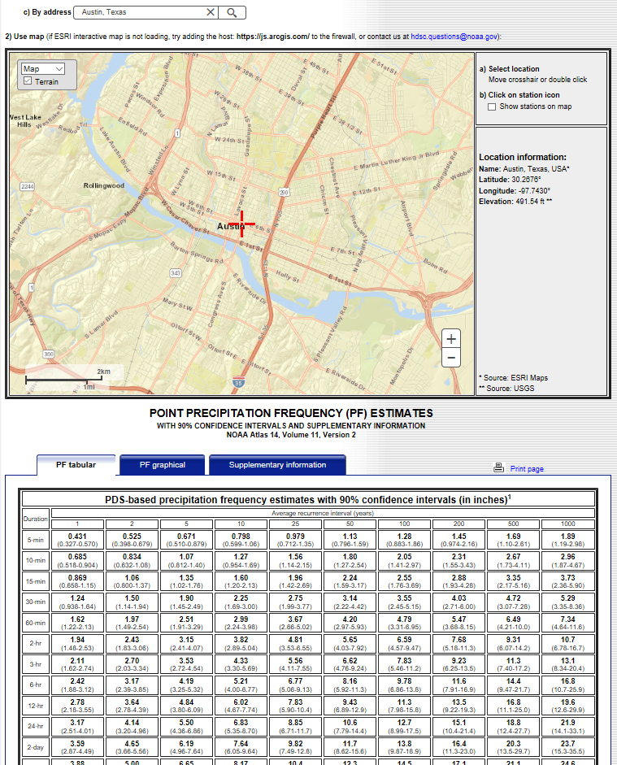
ATLAS 14
A lot of data has been collected and is available
More than just the 100-year, 24-hour rainfall data
NOAA’s Website

Slide 6
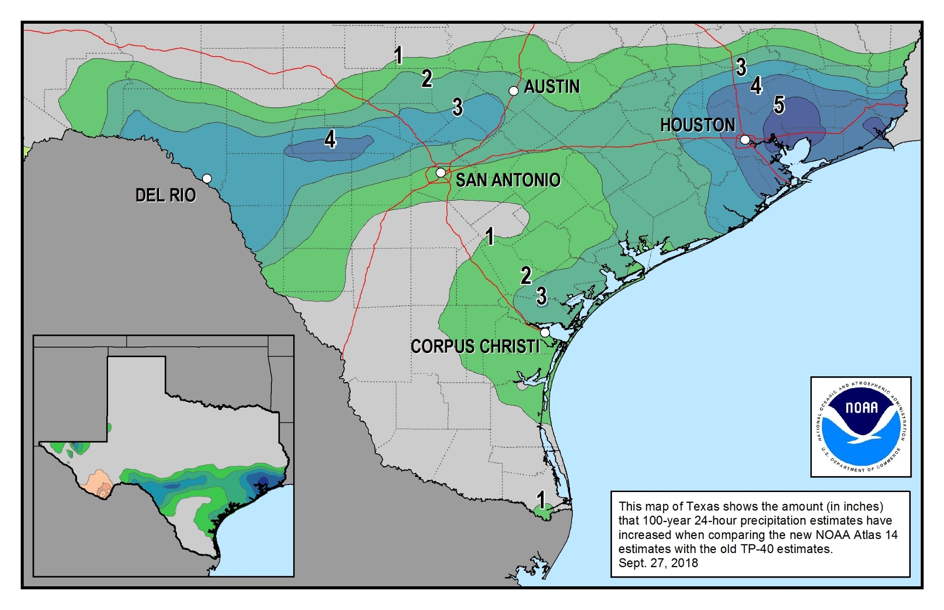
ATLAS 14 Rainfall Changes – Area Impacted in Texas

Slide 7
Key impacts in the City of Austin of
Atlas 14 updated rainfall data
Measure | Current | Updated | Percent Increase
100-year rainfall (24-hour) | 10.2 inches | Up to 13+ inches | 30%
Buildings in 100-year floodplain ⁽¹⁾ | 4,000 | 7,200⁽²⁾ | 80%
Special thank you to Kevin Schunk with the City of Austin for this and then next few Austin slide data
1 – From City of Austin
2 - Excludes Colorado River floodplain and associated lakes

Slide 8
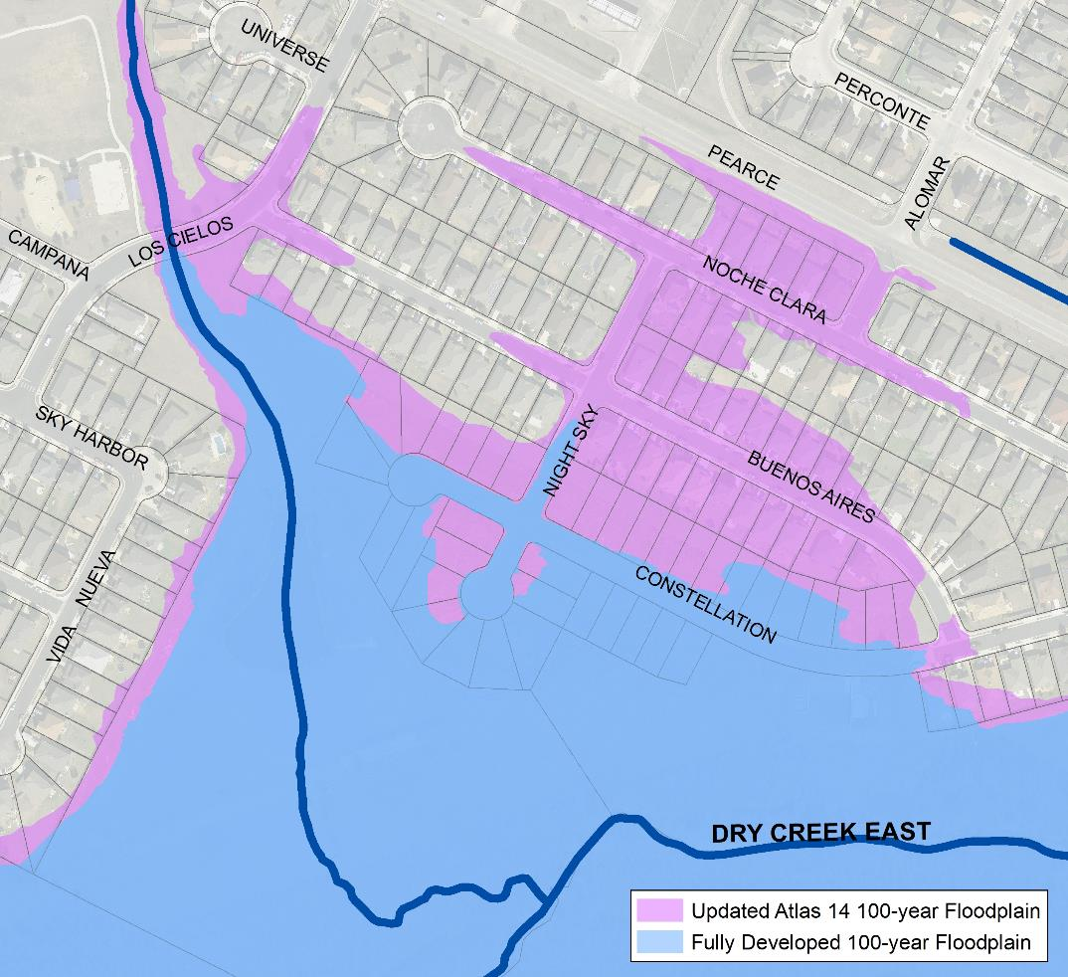
Austin’s Floodplains Will Expand
More homes and businesses are at risk than previously thought.
Affects ability to develop, remodel, or redevelop property.
Affects the need for and the cost of flood insurance.
Floodplains will need to be re-studied.
See impacts at ATXfloodpro.com

Slide 9
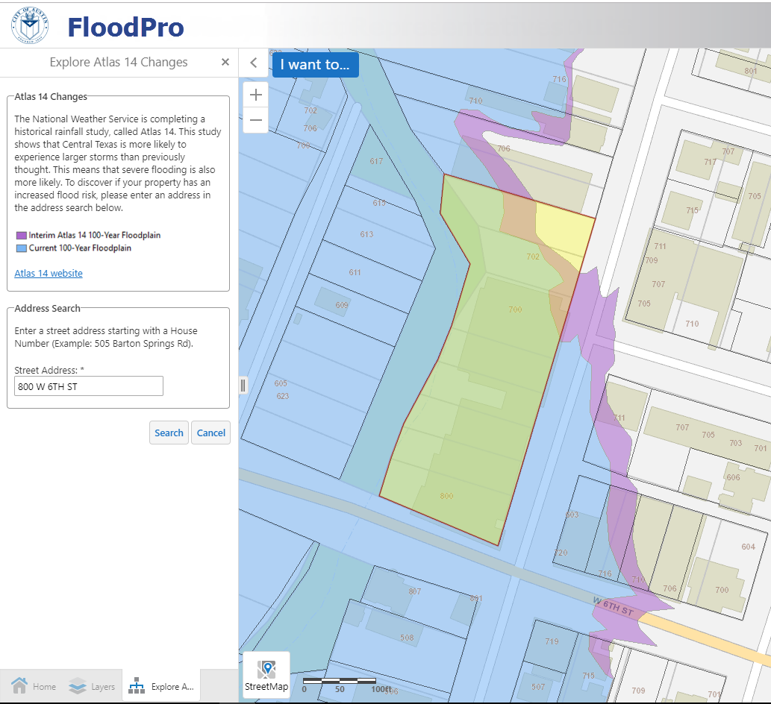

Using FloodPro
Go to ATXfloodpro.com
Click “I want to…”
Click “Explore Atlas 14 Changes”
Enter an address to search

Slide 10
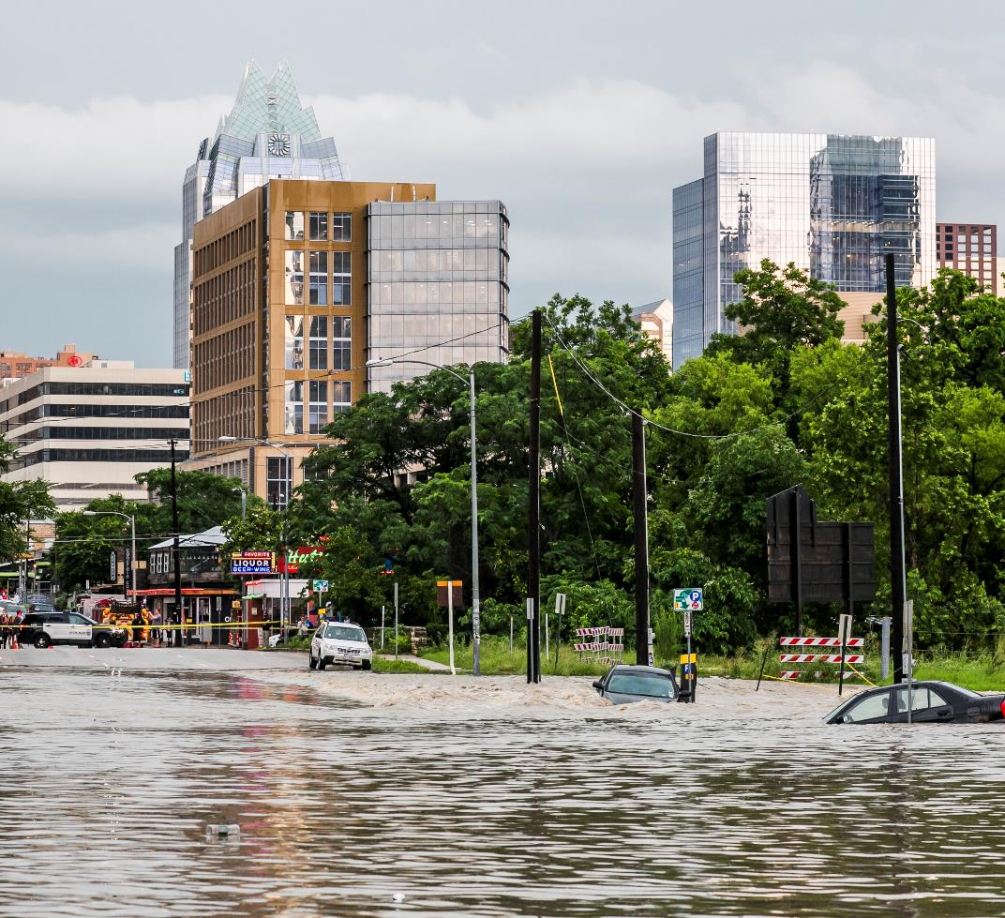
City of Austin’s Response
Other Public Entities
In Central Texas
Recommended Response
Step 1
Land Development Code amendments
Step 2
Drainage Criteria Manual revisions
Step 3
Floodplain Study and Mapping Updates

Slide 11
City of Austin’s Response
Step 1 – Land Development Code Amendments
Review the definition of floodplains:
  New 100-year floodplain updated to what is now the 500-year
  New 25-year floodplain updated to what is now 100-year
  To limit construction of new buildings in areas of known flood risk
Create a redevelopment exception
Expand the Colorado River exception
Increase the freeboard requirements

Slide 12
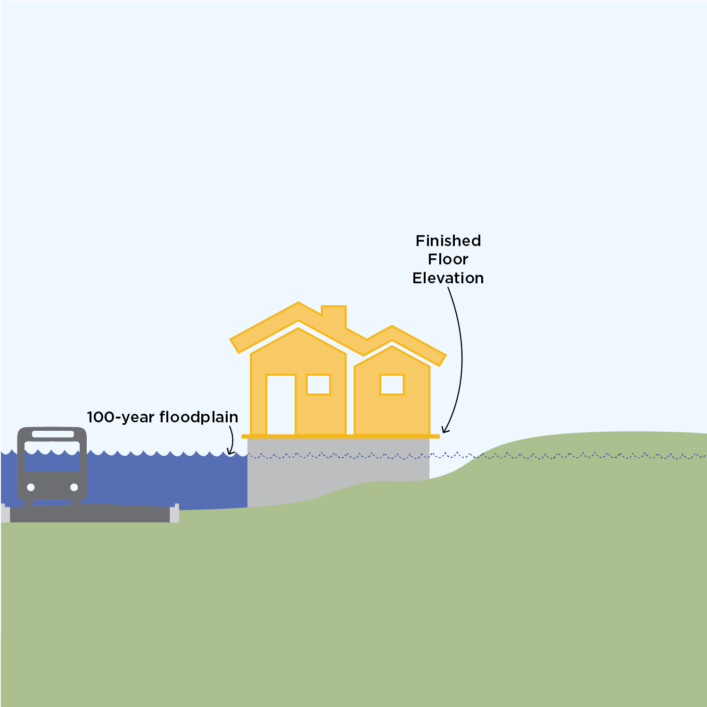
Create a redevelopment exception
    Administrative approval process for a residential building in the floodplain if:
    Replaces an existing residential building
    Finished floor elevation is at least 2 feet above the 100-year floodplain
    Does not increase number of dwelling units
    No adverse flooding impact
    If these 4 conditions are met, the safe access requirement is waived
Notes:
Additions and substantial renovations can be approved if:
The home meets 2 feet freeboard requirement.

Slide 13
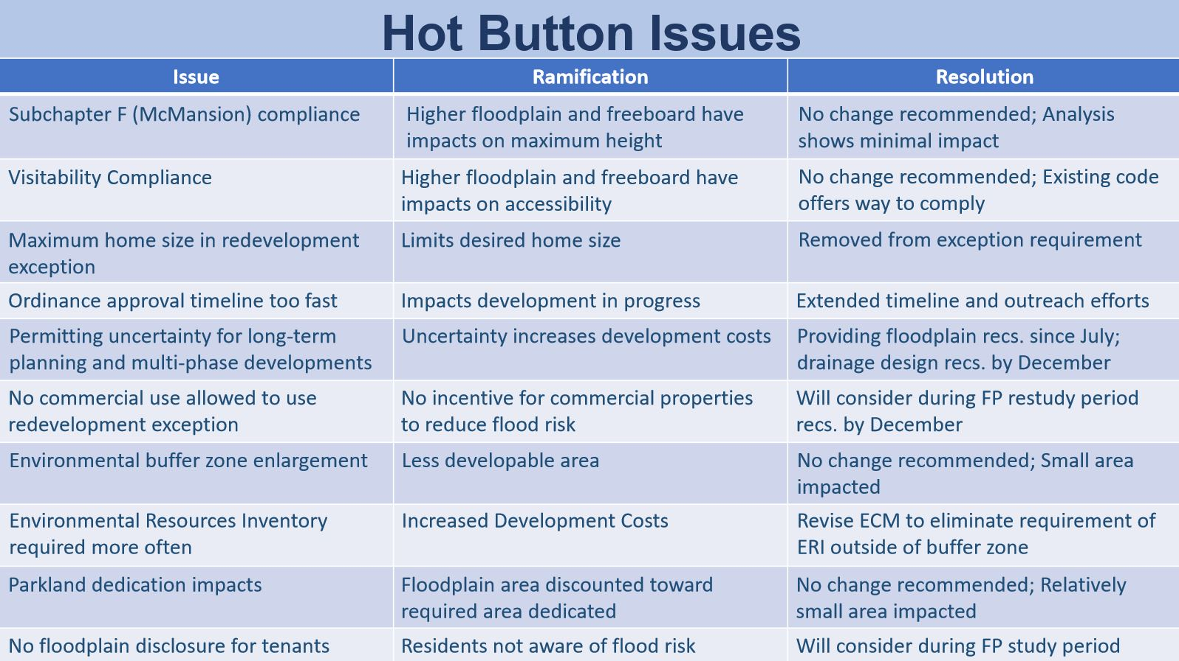
City of Austin’s Response
The City of Austin has been working with a number of stakeholders on the first draft of the ordinance.
Updated draft expected in the next few weeks.

Slide 14
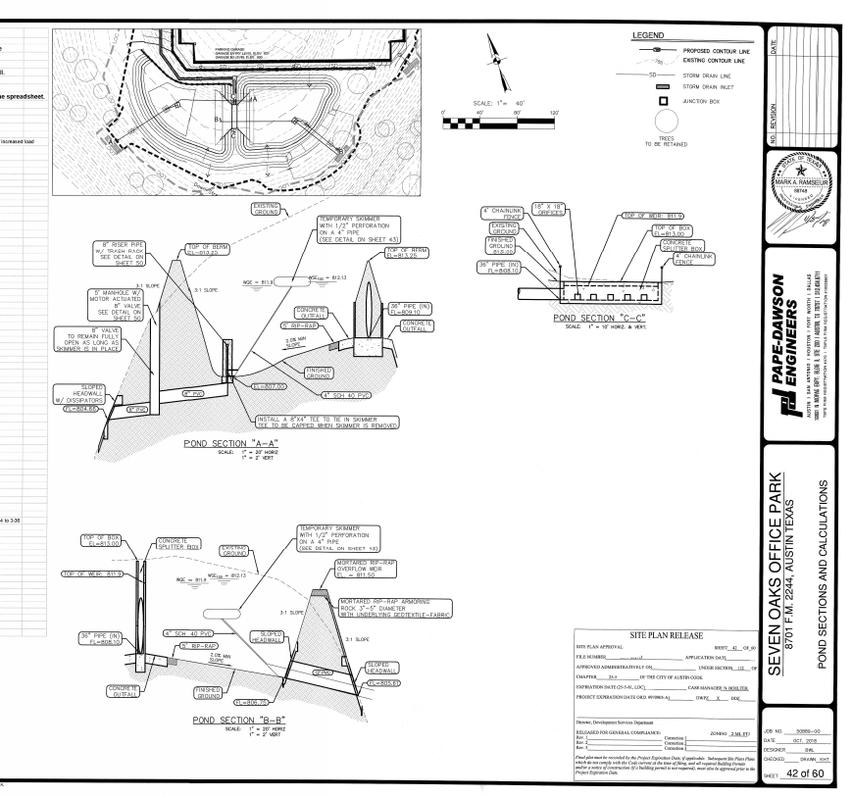
Step 2 Drainage Criteria Manual revisions
  Atlas 14 updates rainfall rates that are used to determine:
    Floodplain location
    Size of storm drain pipes, inlets, and ditches
    Detention pond size
  This is NOT a part of the 1st round draft ordinance revisions. Separate process.
  Phased projects
  Existing drainage infrastructure

Slide 15
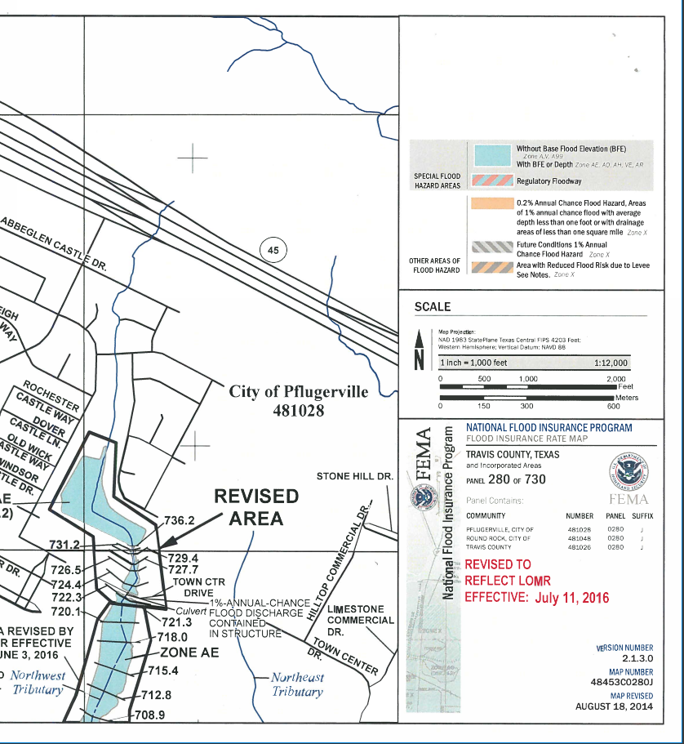
Step 3 Floodplain Study and Mapping Updates
  Process to take 2 - 3 years
  Once complete, will provide data to FEMA to update flood insurance maps

Slide 16
Next Steps/Timeline (from City of Austin)
Now – Discussing stakeholder comments on draft ordinance (Step 1). Updated ordinance language due out late July.
September - November 2019 – Public Hearings at Boards and Commissions and City Council (by end of 2019) to approve step 1 ordinace.
Summer 2019 – Start Drainage Criteria Manual updates (Step 2 rules change process)
2019 to 2021 – Re-mapping of Austin floodplains (Step 3)
2022 – FEMA map updates
Other Entities in Central Texas

Slide 17
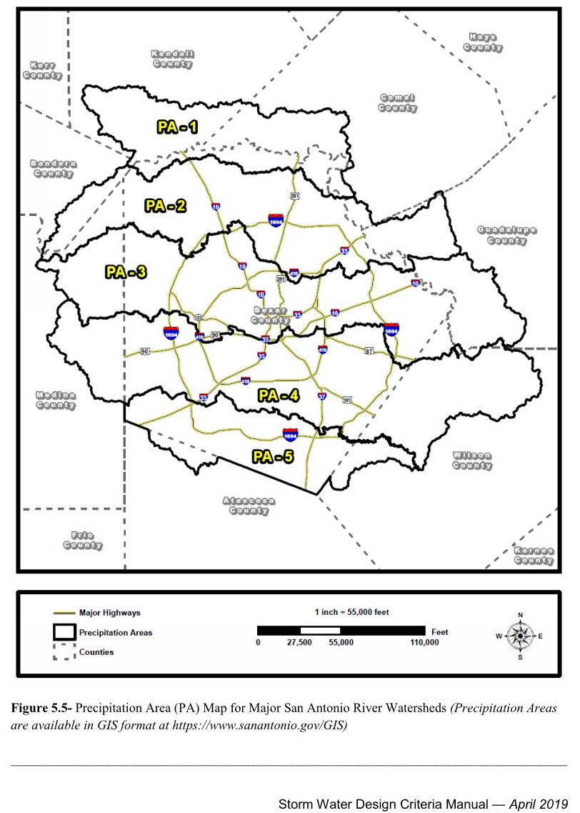
San Antonio Area Update
Adopted new drainage rules/criteria in April 2019.
Includes 5 precipitation areas across the City:
  PA-1 12.87”
  PA-2 12.49”
  PA-3 11.97”
  PA-4 11.50”
  PA-5 11.15”

Slide 18
San Antonio Area Update
Implementation So Far:
  Overall implementation has gone smoothly (everyone understood and was on board, engineers and developers, prior to implementation).
  There was NO grandfathering to the old data
  They are willing to accept a design (such as a detention pond) that was designed using the old data, if you can show it has no impact downstream. It would be deemed “out of compliance” but would be approved.
  The City is open to review special conditions on case by case basis.
  The City is currently updating the FEMA maps to reflect the new data.

Slide 19
Houston Area Update
Largest Impact of any area across Texas
The entire area is updating development codes in response to Atlas 14. Examples:
  Fort Bend County: One rainfall intensity across the county
  Montgomery County: Using the 500 year until the FEMA maps are updated
  Harris County:
    City of Houston will follow the County’s lead
    Expect to have 3 zones of rainfall intensities
    New rules to be adopted in July
    15%, 30%, and 40% increase in rainfall depths 2-yr, 100-yr, and 500-yr, respectively
  Smaller area Cities are doing the same as Counties

Slide 20
Houston Area Update
Implications so far:
  Receiving streams can’t handle increased flows
  Increase in detention volumes
  Increase in storm sewer sizing (10% increased cost)
  2’ of freeboard
  Mitigation of 500-yr floodplain, not just 100-yr floodplain

Slide 21
Questions to ask about property/development site
Is your due diligence/development team aware of ATLAS 14?
Do I have floodplain on my property? Will that change with ATLAS 14?
Where is my drainage outfall and can it take post-ATLAS 14 rainfall events?
Is my project phased and how is that impacted?
How will the 2-foot freeboard (not all areas) impact my grading/ADA? Lot grading?
Should I do an updated flood study (phased project)?
If doing redevelopment in or near a floodplain, meet with the City or other permitting entity.
Flood insurance – Should you get now.

Slide 22
Mark Ramseur, PE
Managing Principal, Central Texas
mramseur@pape-dawson.com
Questions?
10801 N Mopac expy., building 3, suite 200, austin, texas 78759
P: 512.454.8711
C: 512.789.7272

